Slide 1
Caution to the wind
By Santiago Bermudez, Eric Truong, and Amad Shah

Slide 2
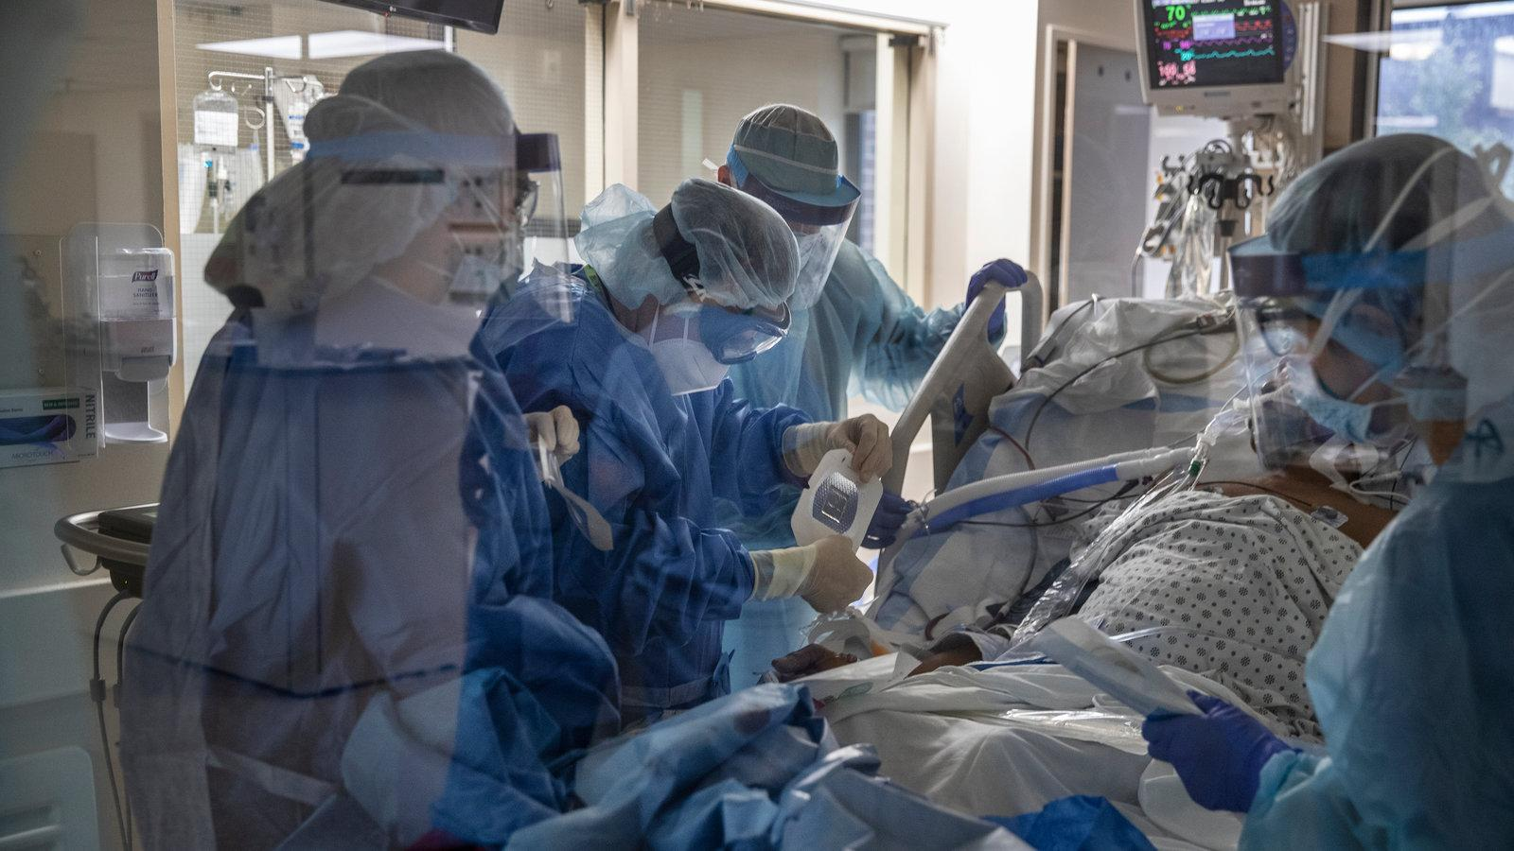
iNTRODUCTION
Thanks to our innovations in modern media technology, we have been able to communicate more now than ever. Unfortunately, with increased communication often comes increased miscommunication. Having miscommunication and an environment that acts against trust can lead to many real world consequences and inefficiencies. It is important that people hold and maintain a strong foundation of scientific literacy to be able to respond intelligently to new developments and to be able to engage in valid protective behaviors that benefit not just themselves, but society as a whole. It is our hope that working with this data can help to further explain why things like testing and vaccination matter. We hope that our results can help to reaffirm the validity of the message that medical experts have spread to the public and to learn more from this Covid pandemic as well as a result of working with this dataset.

Slide 3
Problem Formulation
Our goal is to use the following inputs to predict total_deaths:
*From CovidVaccinations.csv:
- location
- date
- total_tests
- positive_rate
- testspercase
- total_vaccinations
- people_vaccinated
- totalvaccinationsper_hundred
- stringency_index
- population_density
- median_age
- gdppercapita
- diabetes_prevalence
- female_smokers
- male_smokers
- hospitalbedsper_thousand
*From CovidDeaths.csv:
- location
- date
- population
- total_cases
- totalcasesper_million
- totaldeathsper_million
- reproduction_rate
- Total_tests
Our output (*from CovidDeaths.csv):
- total_deaths

Slide 4
Methodology
For this project, the data that we used was a Covid-19 dataset from Kaggle. This dataset consisted of two CSC files, one for Covid deaths and the other for Covid vaccinations. For data preprocessing, we would first check for and get rid of duplicate rows for each CSV file separately and deal with missing values by first getting rid of unnecessary columns in our dataframes. Afters some basic preprocessing, we would merge both data frames on common identifying attributes that both data sets share. In our case, we would merge the datasets on ‘location’, ‘date’, and ‘total tests’.

Slide 5
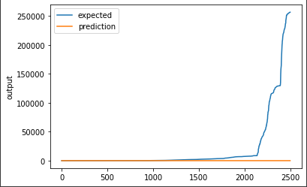
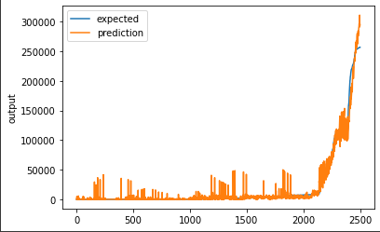
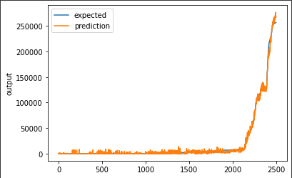
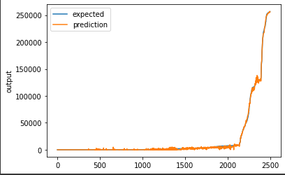
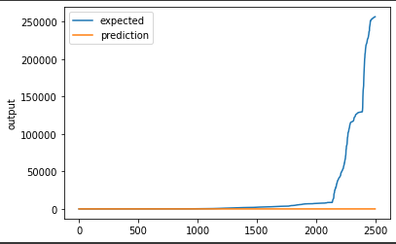
Results
Below are some of the results we got while working on the FCNN model:
Final Score (RMSE): 55888.75
Final Score (RMSE): 55888.74
Final Score (RMSE): 8671.95
Final Score (RMSE): 3334.77
Final Score (RMSE): 1512.92
Final Score (RMSE): 55889.11

Slide 6
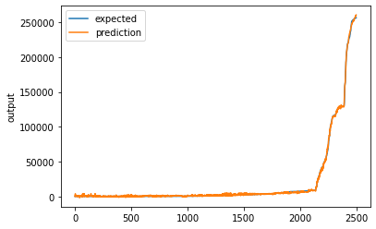
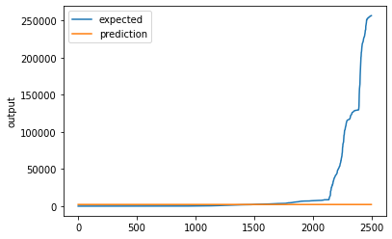
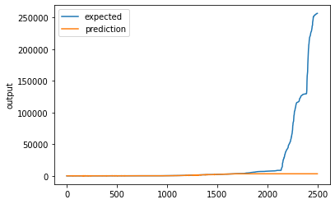
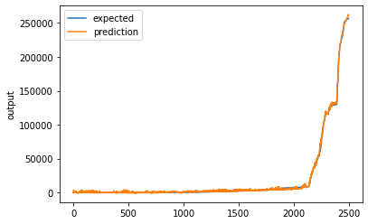
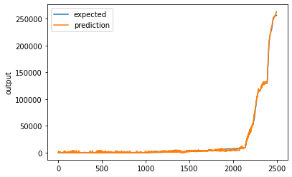
Results
Below are some of the results we got while working on the CNN model:
Final score (RMSE): 1114.9791259765625
Final score (RMSE): 55141.9609375
Final score (RMSE): 54783.0078125
Final score (RMSE): 1471.493408203125
Final score (RMSE): 1654.90673828125

Slide 7
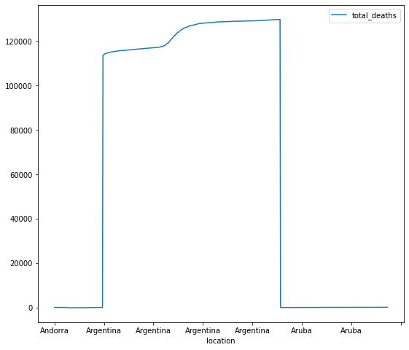
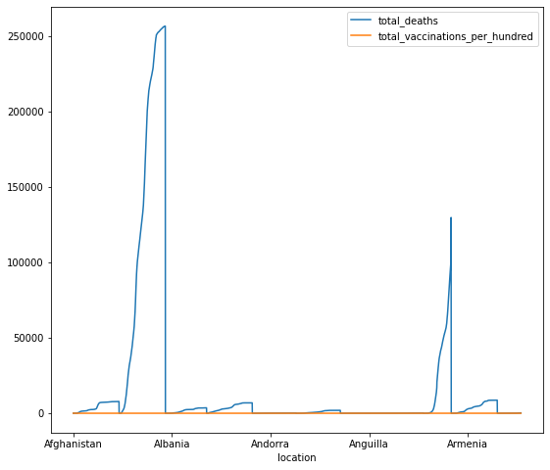
Results
Below are some results we got using predictions from our best model:
For countries in periods of high vaccination:
For countries in periods of low vaccination:

Slide 8
COnclusion
After creating our models and training them, the best model we found was a basic CNN model with ReLU activation, an Adam optimizer, and input that is one row or one line. Using this model, we then went on to split our dataset into something easier to graph and would then graph our results for total deaths based on vaccination rates. For periods of high vaccination, we have seen that the death count is lower and more spread out, which is a good thing because it means that medical resources are less likely to be stretched thin for that period of time. During periods of lack of vaccination, we have seen spikes in death count, which are harder to control and manage.

Slide 9
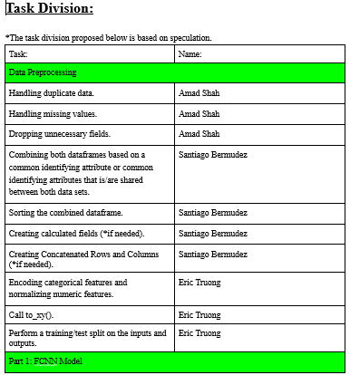
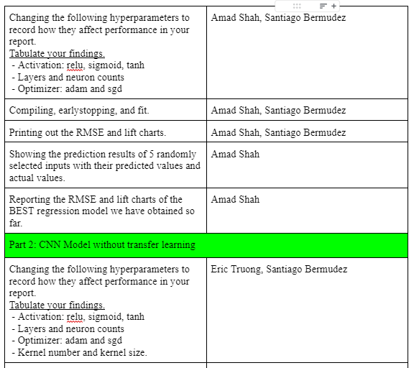
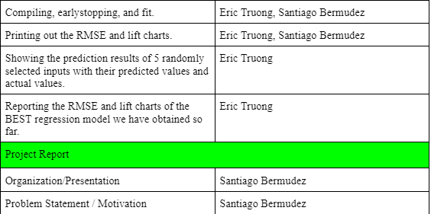
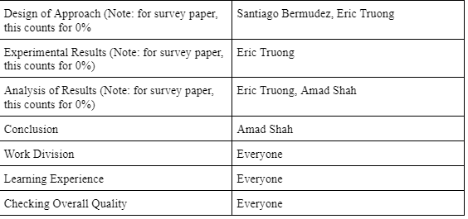
Work Division

Slide 10
Learning Experience
From this project, we have learned that getting vaccinated does in fact help, even if it does not make the problem go away entirely. While the results we got from graphing did confuse us a bit at first, it did turn out to confirm exactly what we are expecting. Generally with better self-protective practices, such as vaccination, we see a trend where fewer people fall ill and perish. We also see a trend where the deaths are more spread out, which means that people are getting impacted at a slower rate, which is preferable because it means that our medical resources and health care workers are not being stretched too thin or strained. We also found that our best model for predicting the results so far was the CNN model and that is it! Thank you!

Slide 11
Thank You!

